Slide 1
Understanding the Effects of Trauma on Health

Slide 2
Defining Trauma
Individual trauma results from an event, series of events, or set of circumstances that is experienced by an individual as physically or emotionally harmful or life threatening and that has lasting effects on the individual’s functioning and mental, physical, social, emotional, or spiritual well-being.
Substance Abuse and Mental Health Services Administration (SAMHSA)

Slide 3
Defining Trauma
Adverse Childhood Experiences (ACEs) are stressful or traumatic events, including abuse, neglect, and household dysfunction, that occur during childhood.
Toxic Stress is a stress response that occurs when a person experiences strong, frequent, and/or prolonged adversity without adequate support.

Slide 4
Examples of Trauma
Examples of trauma include, but are not limited to:
Physical, sexual, and emotional abuse
Childhood neglect
Living with a family member with mental health or substance use disorders
Sudden, unexplained separation from a loved one
Poverty, discrimination, and historical trauma
Violence in the community, war, or terrorism

Slide 5
Prevalence of Trauma: Adverse Childhood Experiences Study
In 1998, more than 17,000 Kaiser Permanente members took the Adverse Childhood Experiences (ACE) Survey.
Results: Two-thirds of respondents had experienced one or more types of ACEs. Of those:
87% experienced
2+ ACEs
22% experienced
3+ ACEs
12.5% experienced
4+ ACEs
Source: Relationship of Childhood Abuse and Household Dysfunction to Many of the Leading Causes of Death in Adults. American Journal of Preventive Medicine , Volume 14 , Issue 4 , 245 – 258.

Slide 6
Types of Adverse Childhood Experiences in the ACE Questionnaire
Substance abuse among household members
Parental separation or divorce
Mental illness among household members
Physically abused by a mother or step-mother
Criminal behavior among household members
Abuse — psychological, physical, or sexual
Neglect, both emotional or physical

Slide 7
Prevalence of Trauma: Philadelphia Urban ACE Study
In 2012 a racially diverse sample of men and women in Philadelphia took a questionnaire that was based on the original ACEs Survey. Respondents were mostly between the ages of 35 and 64, and had completed high school.
Results: More than four out of five respondents experienced at least one ACE:
83% experienced
1+ ACEs
37% experienced
4+ ACEs

Slide 8
Impact of Trauma: 4 or More ACEs = Tipping Point
Compared to people with no ACEs, those with a score of 4 or greater have increased risks for:
Chronic Obstructive Pulmonary Disease: 390% greater risk
Sexually-Transmitted Infections: 240% greater risk
Smoking: Twice as likely
Suicide Attempts: 12 times more likely
Alcoholism: 7 times more likely
Injecting Street Drugs: 10 times more likely
Total estimated lifetime costs associated with one year of child maltreatment: $124 billion

Slide 9
Impact of Trauma: Health, Behavior, and Life Potential
ACEs can have lasting effects on…
Health - obesity, diabetes, depression, suicide attempts, STIs, heart disease, cancer, stroke, COPD, broken bones
Behaviors - smoking, alcoholism, drug use
Life potential - graduation rates, academic achievement, lost time from work
*This pattern holds for the 40+ outcomes, but the exact risk values vary depending on the outcomes.

Slide 10
Impact of Trauma: ACEs and Neurobiology
Traumatic experiences in childhood and adulthood invoke flight, fight, or freeze responses
Responses become toxic when turned on for too long (constant flood of adrenaline and cortisol)
Prefrontal cortex development may become stunted
Traumatic experiences can cause people to see the world as a place of constant danger — resulting in fear, anxiety, depression, anger, etc.
Find solace in alcohol, tobacco, drugs, food, high-risk behaviors, etc.

Slide 11
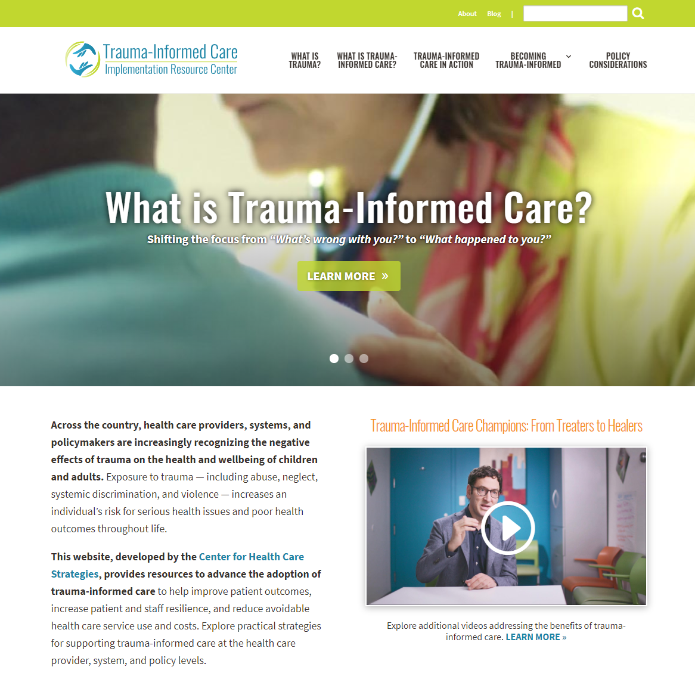
Learn More
This presentation is a product of Advancing Trauma-Informed Care, a national initiative focused on better understanding how trauma-informed approaches can be practically implemented across the health care sector, made possible by the Robert Wood Johnson Foundation and led by the Center for Health Care Strategies (CHCS). CHCS is a nonprofit policy center dedicated to improving the health of low-income Americans.
For more information, visit CHCS’ Trauma-Informed Care Implementation Resource Center at TraumaInformedCare.chcs.org.

